Slide 1
Acoustics Technician Apprenticeship
Garrett Cunningham – Apprenticeship Relationship Manager
DR Hyun Lim – Senior Lecturer

Slide 2
Apprenticeships at LSBU
First provider to offer Acoustics
Academic course content has been guided by employers through industry liaison boards
2500 + apprentices on programme
Dedicated team and apprenticeships resources centre with an investment of £5 million to increase facilities for apprenticeships

Slide 3
Apprenticeship Team
Complete End to End Support
Account manager
Monitoring manager
Ongoing Support
Regular attendance and progress reviews
Skills Coach
Academic Team
Workplace Mentor

Slide 4
What is an apprenticeship?
An apprenticeship is type of training linked to a profession or trade with on-the-job training and a programme of study. Apprenticeships are designed by employers to meet skills gaps, and are a great way to gain real-life experience whilst training and earning a wage.
The apprentice gains this through a wide mix of learning in the workplace, formal off-the-job training and the opportunity to practise new skills in a real work environment.

Slide 5
Acoustics

Slide 6
Course Structure
Duration: 24 months
Classes (blended teaching, i.e. online & in-person)
  Year 1 & Year 2 Semester 1
  Online (max: 20%, e.g. 8 hr / module), otherwise, in-person (80%, e.g. 44 hr)
  Lectures, practical sessions
  To provide lecture notes, handbook including assessment methods, schedule, etc
Workshops including group works
Tutorials & meetings
Assessment:
  Year 1 Semester 1 ~ Year 2 Semester 1: Exam & Coursework each module
  Year 2, Semester 2: EPA must be completed within 6 months, online submission of portfolio

Slide 7
Year Credit Structure
Year 1 and Year 2 (Blended teaching: in-person & online)
Each module: 20 credits, 52 contact hours (44 hr in-person + 8 hr online)
 | Semester 1 | credits | Semester 2 | credits
Year 1 | Engineering Mathematics (part 1) |  | Engineering Mathematics (part 2) | 20
 | Construction Practice (part 1) |  | Construction Practice (part 2) | 20
 | Fundamentals of Acoustics | 20 | Acoustic Instrumentation | 20
Year 2 | Building and Environmental Acoustics | 20 | EPA
 | Subjective and Electro Acoustics | 20 | EPA

Slide 8
Course structure & Assessment
 | Module Title | Level | Year/Semester | Credit value | Assessment weighting (Exam/Coursework)
 | Engineering Mathematics | 4 | 1 / 1+2 | 20 | 50/50
 | Construction Practice | 4 | 1 / 1+2 | 20 | 0/100
 | Fundamentals of Acoustics | 4 | 1 / 1 | 20 | 60/40
 | Acoustic Instrumentation | 4 | 1 / 2 | 20 | 50/50
 | Building and Environmental Acoustics | 4 | 2 / 1 | 20 | 50/50
 | Subjective and Electro Acoustics | 4 | 2 / 1 | 20 | 50/50

Slide 9
Assessment methods - EPA
Work-based portfolio including ten individual pieces of evidence, KSBs-mapped; online platform (more details in the handbook)
Presentation inc. Q&A
In addition, a few Coursework
Notes:
Gov.uk https://findapprenticeshiptraining.apprenticeships.education.gov.uk/courses/463
Knowledge, Skills & Behaviours and they are the main assessment methods used in an End-Point Assessment (EPA)

Slide 10
Entry Requirements
In order to be considered for entry to the course, applicants will be required to have the following minimum qualifications:
Five GCSE passes in five subjects (grade C or above), including English Language and Mathematics (reformed GCSEs grade 4 or above).
Additionally, applicants must possess one of the following:
A-levels EEE (must Include Maths) or
BTEC National Diploma (MPP) or
Access Level 3 qualifications worth 48 UCAS points (must include Maths).

Slide 11
Funding
Non-Levy Employer*
Employer Co-investment (5%): £550 (invoiced)
ESFA (95%): £10,450
Total: £11,00
Levy Employer
Funding Band: £11,000
Total: £11,00
*As an employer that doesn't pay the apprenticeship levy, you pay just 5% towards the cost of training and assessing an apprentice. The government will pay the rest up to the funding band maximum. Unless the applicant is 18 years of age on the start date of the apprenticeship (not employment) and the employer has under 50 employees

Slide 12
Digital Apprenticeship Service

Slide 13
Digital Apprenticeship Service
All non-levy employers (under £3million PAYE) are required to create an Digital Apprenticeship Service. The registration and new YouTube links to offer guidance:
https://www.gov.uk/guidance/manage-apprenticeship-funds
  How to Register: https://www.youtube.com/watch?v=NC3RzRrvgoc&t=155s
  Reserve Funding: https://www.youtube.com/watch?v=mCJxL2ncIrg&t=20s
  Adding Apprentice(s): https://www.youtube.com/watch?v=4jcUqiStyA4&t=1s

Slide 14
Introduction to Apprenticeship Training and Monitoring

Slide 15
Apprenticeship Systems
Academic Qualification
HNC, Degree or Masters
Moodle
Microsoft Teams
APTEM
The Apprenticeship Standard
Knowledge, Skills & Behaviours (KSB’s)
The Job (80% ‘on the job’ training)
APTEM
Tasks may be set up via Moodle
External EPA system if applicable
End Point Assessment Preparation (EPA)
APTEM
External EPA system if applicable
Gateway
APTEM
End Point Assessment (EPA)
IFA Assessment Plan
APTEM
External EPA system if applicable
ACHIEVEMENT &
CERTIFICATION
20% ‘off the job’ Training Log
APTEM

Slide 16
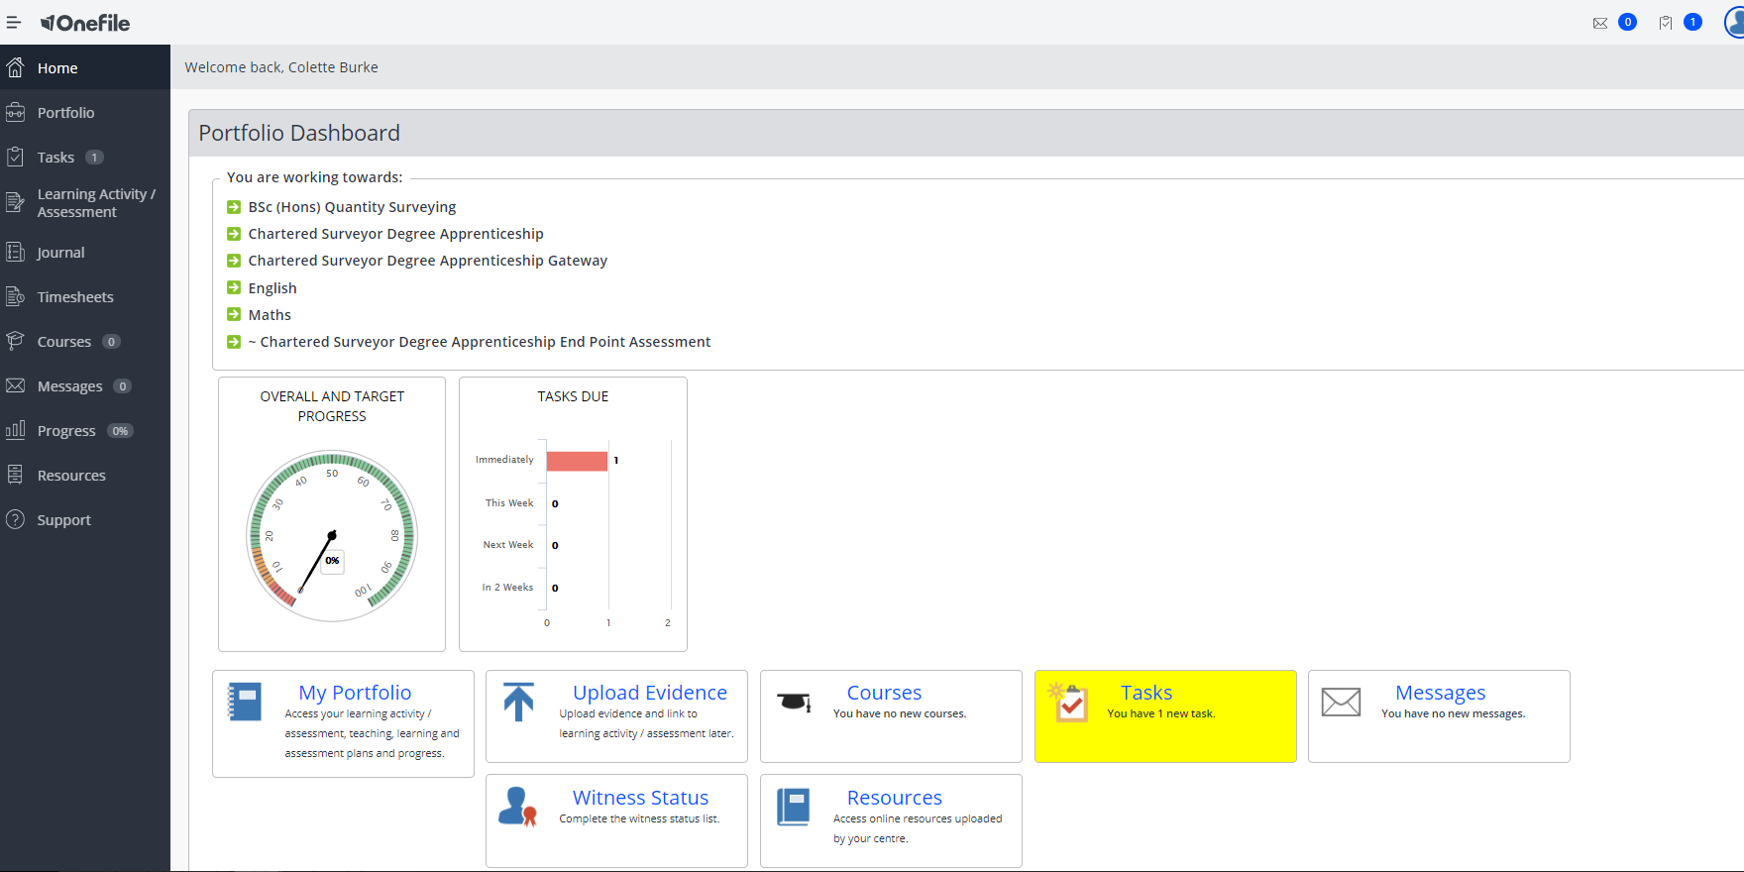
APTEM: E-Portfolio
Progress Reviews are recorded and signed by apprentices and employers
Attendance reports and results are stored
Apprentices log their 20%
Apprentices store evidence of the Standard
Apprentices store evidence for their EPA

Slide 17
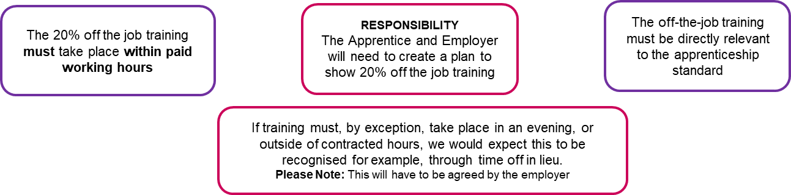
The 20% - To be logged on OneFile
ESFA Definition
‘Off-the-job training is defined as learning which is undertaken outside of the normal day-to-day working environment and leads towards the achievement of an apprenticeship. This can include training that is delivered at the apprentice’s normal place of work but must not be delivered as part of their normal working duties.’
Formula example:
You are paid to work from Monday to Friday = 35hrs per week
Your Degree is 5 Years = 60 months
35 hours per week x 46.4 weeks (52 week – minus holiday 28 days) x 5 years = total work hrs for the duration of the course 8120
20% of 8120 hrs = 1624 hrs over the full duration of the apprenticeship

Slide 18
20% off the Job Training
The 20% Can include: | The 20% Does not include:
The teaching of theory – Your day at University For example: lectures, role playing, simulation exercises, online learning or manufacturer training | Progress Reviews
Practical training For example: Shadowing, job rotation, industry visits and attendance at competitions | On-programme assessment (tests & exam) required for the apprenticeship standard
Group discussions & tutorials | Training which takes place outside of your paid working hours
Learning Support If applicable | Induction into university or work place
Time spent writing assessments / assignments | Revision
Coaching / Mentoring sessions
Activities all need to take place within the apprentice’s paid working hours

Slide 19
Logging 20%
Date | Duration | Activity | Evidence | What did you learn? What KSB’s did you develop
28/9/20 | 180 minutes | Management Training Course at work | Notes, power points from lesson and recording Calendar invite Email | This week was the Introduction to Management module where we looked at different types of management. This is linked to the following KSB’s: K 3, 7 & 11 S 1, 8 B 1, 2, 8 & 13
30/9/20 | 30 minutes | Shadowed Manager during a Tender meeting with a client for a new luxury residential development. The following topics were discussed ……………. | No evidence other than meeting invite as was a confidential meeting | This was the first time observing this type of meeting take place. This is what I learnt
1/10/20 | 60 minutes | Construction Practice Lecture on Microsoft Teams | Notes, PowerPoint, link to lecture recording | K 1,2 & 3 S 1, 2 & 3 B 1, 2, 8 & 13
5/10/20 | 45 minutes | Research for course work for Construction Technology Coursework on University day | Links to what was read Draft of work Assignment brief | Summarise as above

Slide 20
Attendance is important and MANDATORY!
Employer will receive attendance reports
Apprentices have agreed in the Commitment Statement to achieve a minimum of 85% attendance per year
It is their responsibility to ensure they log their attendance
Any justified absence must be reported formally to the Attendance Team email to be recorded

Slide 21
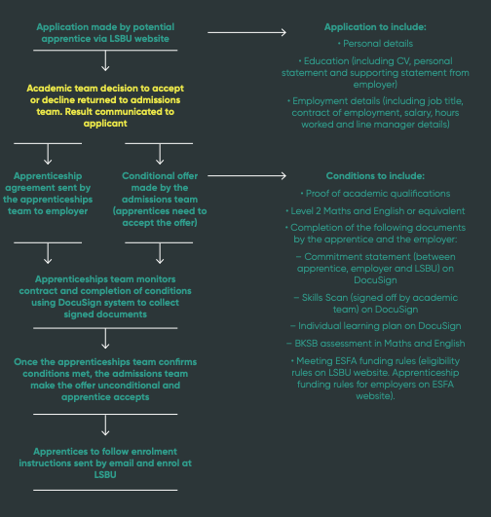
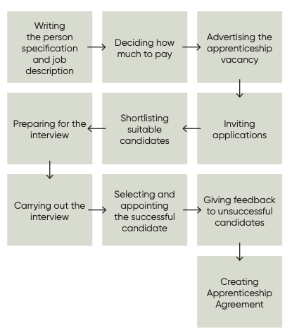
Recruitment Journey

Slide 22
Support
Apprentices advised not to wait to be asked if they need support and are encouraged not to be afraid to ask for support
Support is available via:
The Perry Library
The Well Being Team
Student Life Centre
DDS - Dyslexia & Disability Support
Disability & Dyslexia Support (DDS) is a dedicated service for students who have a disability, mental health condition, medical condition or specific learning difficulties (including dyslexia).
Email: disability@lsbu.ac.uk
Phone: 0207 815 6454

Slide 23
Mental Health & Wellbeing
We provide a supportive and empathetic space to discuss difficulties and advise on what might help apprentices feel better, working together to create a support plan.
Who do we support?
Existing mental health conditions (such as anxiety, depression, personality disorders and bipolar disorder)
Stress and worry
Life stressors
Relationship difficulties (including difficulties with your friends, family, partner or children)
Unhappiness, low mood and loneliness
Bereavement
Students who have been a victim of crime
Support might include:
Confidential and collaborative discussion with a Mental Health & Wellbeing Advisor
Developing a support plan with next steps
Self-help resources
Referral to our counselling service, including online platform SilverCloud
Liaison with other university staff and referrals to other teams
Liaison with external support, such as GP or NHS mental health team
Signposting to relevant external agencies
Apprentices can book in person at the Student Life Centre, phone 020 7815 6454 or email studentwellbeing@lsbu.ac.uk

Slide 24


Slide 25

Apprenticeship standards (SBC)
Level 2 Bricklayer Apprenticeship
Level 2 Commis Chef Apprenticeship
Level 2 Hospitality Team Member Apprenticeship
Level 2 Production Chef Apprenticeship
Level 3 Business Administration Apprenticeship
Level 3 Chef De Partie Apprenticeship
Level 3 Dental Nurse Apprenticeship
Level 3 Early Years Educator Apprenticeship
Level 3 Electrician Apprenticeship
Level 3 Team Leader/Supervisor Apprenticeship
September 2022
Level 3 Civil Engineering Technician Apprenticeship
Level 3 Surveying Technician Apprenticeship
Level 3 Building Services Design Technician Apprenticeship

Slide 26
LSBU Apprenticeship Standards
Arts and Creative Industries
Post Production Technical Operator (level 4)
Business
Chartered Manager Degree (level 6)
Engineering
Rail and Rail Systems Engineer (5 pathways) (level 5)
Rail and Rail Systems Senior Engineer (6 pathways) (level 6)
Digital Marketer Degree (level 6)
Digital and Technology Solutions (6 paLSBU Apprenticeship Standardsthways) (level 6)
Health and Social care
Healthcare Assistant Practitioner (level 5)
Senior Leader (level 7)
Nursing Associate (level 5)
Law and Social Sciences
Chartered Town Planner Standard (level 7)
Level 4 Entry: PgDip Chartered Town Planner
Level 7 Entry: MA Chartered Town Planner
Level 7 Entry: MA Chartered Town Planner (Urban Design)
Embedded Electronic Systems Design and Development Engineer (level 6)
Operating Department Practitioner (level 6)
Clinical Associate in Psychology (level 7)
https://www.lsbu.ac.uk/study/apprenticeships/apprenticeship-standards

Slide 27
The Built Environment and Architecture
Architect Apprenticeship (level 7)
The Built Environment and Architecture
Building Services Engineering Technician (level 4)
The Built Environment and Architecture
Construction Quantity Surveyor (level 6)
Architectural Assistant (level 6)
Building Service Design Engineer (level 6)
Building Services Engineering site Management (level 6)
Chartered Surveying Degree (Quantity Surveying) (level 6)
Chartered Surveying Degree (Building Surveying) (level 6)
Construction Site Management (level 6)
Design and Construction Management (level 6)
Construction Quantity Surveyor Technician (level 4)
Civil Design Engineer (level 6)
Construction Site Engineering Technician (level 4)
Construction Design and Build Technician (level 4)
Construction Site Supervisor (level 4)
Acoustics (level 4)

Slide 28
Thank you

